Slide 1

Global Pandemic Defense & Economic Impact Analysis
A comprehensive data-driven examination of pandemic preparedness across 231 countries, analyzing how defense infrastructure, healthcare investment, and infection dynamics influence economic resilience. Created by Satheesh Sharun using Tableau, Python, and Excel.

Slide 2

Project Objective
Economic Impact Assessment
Defense & Medical Analysis
Quantify pandemic-driven GDP loss patterns across diverse economic landscapes and identify vulnerability factors.
Examine correlations between defense preparedness levels, medical spending capacity, and infection containment outcomes.
Interactive Intelligence
Risk Classification Framework
Develop dynamic Power BI dashboards enabling real-time exploration of multidimensional pandemic risk indicators.
Establish standardized metrics for cross-country comparison, supporting evidence-based policy prioritization.

Slide 3


Dataset Overview
Comprehensive Global Coverage
Our analysis encompasses 231 countries, providing unprecedented geographic breadth for pandemic economic impact research. The dataset integrates economic indicators, healthcare infrastructure metrics, and epidemiological data.
Critical Variables Examined
GDP Loss Percentage: Economic contraction during pandemic period
Defense Level: Categorized as Bad, Good, or Excellent based on preparedness infrastructure
Infection Ratio: High vs. Low infection rate classifications
Medical Spending: Per capita healthcare investment levels
Population: Demographic scale affecting intervention capacity
Data Integrity: Custom dataset meticulously cleaned and validated through multi-stage processing using Excel and Python workflows.

Slide 4




Data Preparation & Transformation
Categorical Encoding
Converted defense level classifications to numeric scale (1=Bad, 2=Good, 3=Excellent) enabling quantitative correlation analysis.
Data Cleansing
Identified and resolved null values in medical spending and population fields through imputation and validation protocols.
Distribution Analysis
Implemented intelligent binning strategies for histogram visualization, revealing meaningful patterns in GDP loss clustering.
Calculated Metrics
Engineered derived fields including normalized GDP Loss %, Defense Score Numeric, and Infection Risk Ratio for enhanced analytical depth.

Slide 5
Key Performance Indicators
-5.02%
1.745
231
59
Average GDP Loss
Average Defense Score
Countries Analyzed
Excellent Defense Nations
Mean economic contraction across all analyzed countries
Comprehensive global dataset coverage
Global preparedness rating on 1-3 scale
Countries achieving highest preparedness tier
Critical Finding: Statistical analysis reveals a strong negative correlation between defense score and GDP loss severity. Countries with excellent defense infrastructure experienced significantly reduced economic impact, validating the importance of proactive pandemic preparedness investment.

Slide 6
Dashboard 1: Multi-Dimensional Insights
Analytical Components
Key Discoveries
01
Economic Impact Clustering
GDP Loss Distribution
Majority of nations experienced GDP loss between -1% to -15%, with outliers indicating extreme vulnerability or exceptional resilience.
Histogram revealing concentration patterns
02
Medical Spending Analysis
Defense-Infection Nexus
Cross-country investment comparison
High infection ratio clusters concentrate overwhelmingly in the Bad Defense Level category, demonstrating preparedness efficacy.
03
Defense-Economy Correlation
Healthcare Investment Disparity
Impact visualization by preparedness tier
Medical spending exhibits dramatic regional variation, with implications for pandemic response capacity and outcome differentiation.
04
Infection Risk Matrix
Multi-variable vulnerability assessment

Slide 7
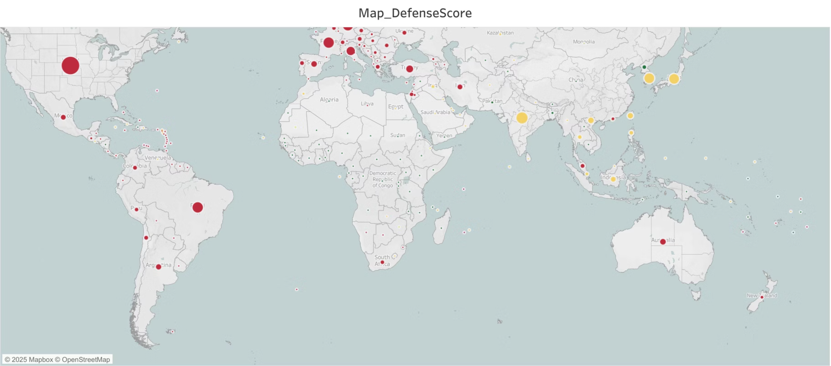

Slide 8
Dashboard 2: Global Geographic Patterns
1
North America & Europe
Demonstrate consistently higher defense scores, reflecting robust healthcare infrastructure and pandemic preparedness systems.
2
African Continent
Reveals multiple low-defense clusters, highlighting systemic vulnerability and urgent need for capacity-building interventions.
3
Asian Region
Exhibits heterogeneous distribution with defense levels strongly correlated to medical spending variations across subregions.
The geographic heat map visualization, rendered using defense score gradients, exposes striking regional disparities in pandemic preparedness infrastructure and suggests strategic priorities for international health security investment.

Slide 9
Risk Matrix Analysis
Matrix Dimensions
High-Risk Zone
X-Axis: Defense Level progression from Bad through Good to Excellent
Bad defense + high infection = Critical vulnerability requiring immediate intervention
Y-Axis: High Infection Ratio binary classification
Bubble Size: Population magnitude indicating scale of potential impact
Moderate Zone
Mixed indicators suggest targeted improvements needed
Safe Zone
Good/Excellent defense + low infection = Optimal resilience
The risk matrix reveals that excellent defense infrastructure dramatically reduces infection impact regardless of initial exposure levels, demonstrating the protective value of preparedness investment.

Slide 10
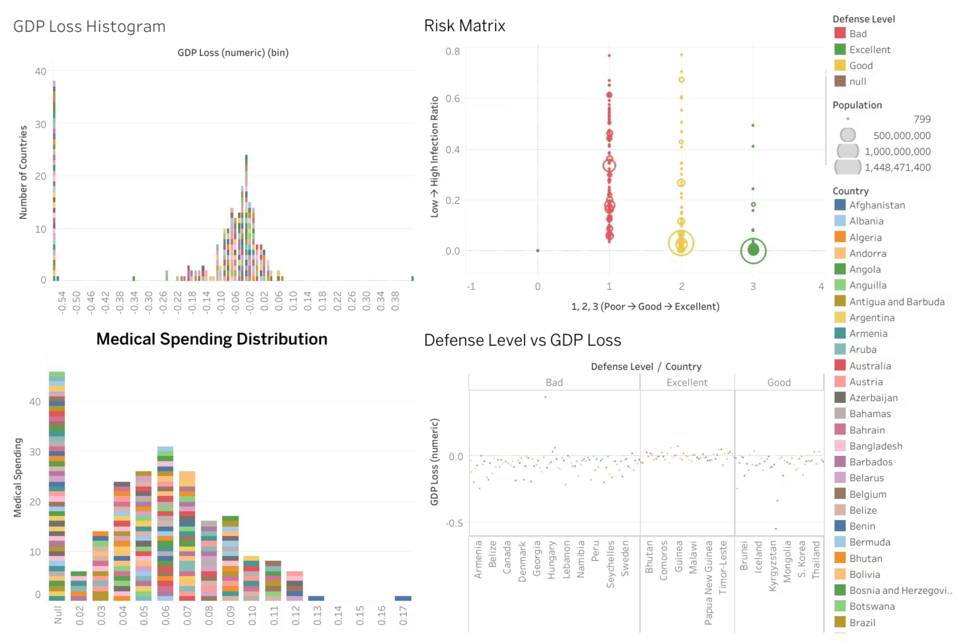

Slide 11
Conclusion & Future Directions
Core Conclusions
Future Development Roadmap
Defense-Economy Linkage
Predictive Modeling
Robust statistical evidence confirms defense level as primary determinant of GDP stability during pandemic events.
Integrate machine learning algorithms to forecast GDP loss scenarios under varying preparedness conditions.
Medical Investment ROI
Temporal Analysis
Healthcare spending correlates with enhanced resilience, reducing both infection rates and economic disruption severity.
Build longitudinal dashboards tracking defense score evolution and economic recovery trajectories over multi-year periods.
Strategic Visualization
The Risk Matrix framework provides actionable intelligence for prioritizing national capacity-building interventions.
Policy Recommendations
Develop country-specific intervention strategies based on risk classification and resource optimization modeling.

